Slide 1
New Hanover Township
2024 Budget Presentation

Slide 2
What’s a budget?
Notes:
A budget is an estimation of revenue and expenditures over an annual basis and should be reviewed throughout the year.
It’s a planning tool for success. You need one!

Slide 3





Slide 4
What’s in the budget?
Letter of Transmittal (Budget Message)
Fund Budgets
Supporting Data (Budget Schedules)
These documents are located on our website at
www.newhanover-pa.org.
Notes:
The Letter of Transmittal is an overview of the budget in commentary form and provides a narrative review of significant trends and factors affecting the proposed budget and highlights areas of importance in the financial section. It also contains a summary of program and service delivery, cash position, and revenue and expense projections.
The proposed 2024 Budget consists of 13 funds detailing the projected revenues and proposed expenditures for the coming year in line-item format. A three-year history of actual (audited) revenues and expenditures and year-end estimates for the current year indicate trends and beginning and ending fund balances show cash position.
The Supporting Data (Budget Schedules) offer an additional level of detail for specific line items in each operating budget.

Slide 5

Budget Highlights
The proposed budget maintains current tax rates.
There are two new staff positions in the proposed budget.
The proposed budget maintains municipal services at current levels.
Capital appropriations maintain infrastructure and equipment.

Slide 6





The proposed budget maintains current tax rates.
REAL ESTATE ASSESSMENT & TAX LEVY SUMMARY
2005 to 2024
Year | Assessment | Township | School | County | TOTAL
2005 | 515,461,749 | 1.560 | 17.250 | 2.890 | 21.700
2006 | 542,242,259 | 1.680 | 18.630 | 2.890 | 23.200
2007 | 558,134,099 | 1.680 | 19.420 | 2.840 | 23.940
2008 | 573,092,899 | 1.680 | 20.030 | 2.695 | 24.405
2009 | 594,350,849 | 1.680 | 19.660 | 2.695 | 24.035
2010 | 609,002,899 | 1.680 | 20.360 | 2.695 | 24.735
2011 | 627,427,459 | 1.680 | 21.500 | 2.695 | 25.875
2012 | 641,466,680 | 1.680 | 22.490 | 3.152 | 27.322
2013 | 655,576,000 | 1.680 | 22.970 | 3.152 | 27.802
2014 | 667,524,270 | 1.680 | 23.270 | 3.152 | 28.102
2015 | 683,039,820 | 1.680 | 23.860 | 3.152 | 28.692
2016 | 700,772,300 | 1.680 | 23.860 | 3.459 | 28.999
2017 | 712,603,640 | 1.680 | 24.270 | 3.849 | 29.799
2018 | 720,809,860 | 1.680 | 25.020 | 3.849 | 30.549
2019 | 735,355,240 | 1.587 | 26.370 | 3.849 | 31.806
2020 | 748,512,420 | 1.587 | 27.330 | 3.849 | 32.766
2021 | 766,142,700 | 1.587 | 28.200 | 4.022 | 33.809
2022 | 786,921,832 | 1.587 | 29.046 | 4.022 | 34.655
2023 | 791,919,812 | 1.587 | 29.917 | 4.313 | 35.817
2024 | 795,879,411 | 1.587 | 29.917 | 4.313 | 35.817
Notes:
We have 4 tax levy’s – General Fund (0.957), Fire Protection Fund (0.310), Road Equipment Capital Fund (0.180) and Recreation Fund (0.140). This will be the 18th year in a row that taxes have not been increased; we reduced them by 5% in 2019.

Slide 7

LOCAL TAX MILLAGE COMPARISON
Notes:
USE PEN -- Township @ 5% -- County at 12% and School District at 83% -- At the current tax levy of 1.587 mills, real estate taxes for a home assessed at the average assessment value of $155,475 would pay $243 per year or about $20 per month for Township services.

Slide 8
There are 2 new staff positions in the proposed budget.
Department | Current | Replacement | Proposed New
Executive | 1 | 0 | 0
Finance Department | 1 | 0 | 0
General Administration | 2 | 0 | 0
Police Department | 13 | 0 | 1.5
Code Enforcement and Zoning | 2 | 0 | 0
Public Works Department | 7.5 | 0 | 0
Parks and Recreation Department | 0 | 0 | 0
Municipal Authority (Sewer) | 4 | 0 | 0
 | 30.5 | 0 | 1.5
Notes:
At full staffing levels, we have 33 employees: 31 FTE and 2 PTE. In 2024 we will have 31 FTE, 1 PTE (Public Works Laborer) and 1 PTE (Police), and 9 lifeguards as seasonal employees.

Slide 9
Budget Overview

Slide 10
Notes:
USE PEN - There are 13 Funds in the proposed budget (1 Governmental Fund, 5 Special Revenue Funds, 3 Capital Project Funds, 2 Enterprise Funds, and 2 Trust Funds). The Government Finance Officers Association (GFOA) recommends a municipality to have between 8% and 12% in fund balance reserves. At the end of 2024, the General Fund will have approximately 32% in fund balance reserves.

Slide 11
Notes:
The General Fund is the largest Operating Fund and accounts for many common local government services, including police protection; planning and zoning; general administration; finances; legal and engineering services; tax collection services; and public works services and maintenance.
General Fund appropriations total $5.43 million. Appropriations in the Special Revenue Funds include the Fire Protection Fund ($343,500), Open Space Fund ($354,500), Transportation Impact Fund ($100,000), Recreation Fund ($199,000) and Liquid Fuels Fund ($409,000). Appropriations for the Sewer Operating Fund total $2.56 million. Combined capital appropriations total $2.34 million and pension funds total $603,000.

Slide 12
Notes:
The General Fund, in combination with the Sewer Operating Fund and Recreation Fund, account for all personnel, fringe benefit, insurance, routine maintenance and operational expenditures. Personnel costs remain the largest single expense in the operating budgets representing 21.6% of total appropriations. Operating expenses, contracted services, professional services, and insurance account for an additional 23% of budgeted expenditures. These percentages usually combine to be the highest expenses in local governments as public service agencies and demonstrate that significant cost cutting can only occur with staff reductions that directly affect service delivery.

Slide 13
Budget Highlights
Notes:
Revenue then expenses for GF

Slide 14
Notes:
The primary revenue sources for the General Fund are real estate taxes, Act 511 taxes (earned income, per capita, local services, and transfer taxes), business licenses, permit fees, grants, state-shared entitlements, and charges for service. Let’s see some examples.

Slide 15
SCHEDULE B
EARNED INCOME TAX COLLECTIONS
2014 - 2024
 | General Fund | Open Space Fund | Total | % Change
2014 | $ 1,689,221 | $ 530,511 | $ 2,219,732 | -
2015 | 1,723,990 | 507,072 | 2,231,062 | 0.51%
2016 | 1,880,496 | 559,550 | 2,440,046 | 9.37%
2017 | 1,966,395 | 588,693 | 2,555,088 | 4.71%
2018 | 2,074,956 | 620,863 | 2,695,819 | 5.51%
2019 | 2,203,395 | 659,720 | 2,863,115 | 6.21%
2020 | 2,329,701 | 693,357 | 3,023,058 | 5.59%
2021 | 2,623,427 | 777,880 | 3,401,307 | 12.51%
2022 | 2,816,773 | 832,566 | 3,649,339 | 7.29%
2023 (est) | 3,012,896 | 883,415 | 3,896,311 | 6.77%
2024 Budget | 3,103,283 | 909,918 | 4,013,200 | 3.00%
Notes:
Local enabling taxes account for almost 2/3rds of our revenue. The Township levies a 1% earned income tax and revenue generated from residents is shared equally with the Boyertown School District. Earned income taxes will generate a projected $3.1 million in 2024, representing 64% of total revenues in the General Fund. Real estate taxes are projected to come in close to $759,000, representing about 16% of total revenue in the General Fund.

Slide 16
Notes:
Transfer taxes are a tax on real estate sales within the Township. The tax rate is 2% of the sale price. County government receives 1% of the tax proceeds, and the Boyertown School District and Township share the remaining 1% equally. Transfer tax receipts have steadily increased throughout the past several years as the real estate market is strong and development completed in the Township. However, as interest rates continue to climb, current projections indicate transfer tax receipts in 2024 will be reduced to approximately $288,000.
An estimated 180 properties will transfer ownership in 2024, which is projected to be significantly less than data in 2021 and 2022. Both of those data sets were based on citizens taking advantage of historically low mortgage rates, but the trend has reversed course in 2023. There has been an average of 8.6% of the existing parcel stock (344 properties) transferred over the previous three years. Construction activity enhances transfer tax revenue and new construction will increase assessed value and real estate tax revenue and minimizes the need for future real estate tax increases.

Slide 17
Notes:
Revenue from permit fees has remained steady since 2014, but this will not be a major income stream in 2024 as approved developments finished their projects. Permit fee revenue in 2024 is estimated at $86,500. The Township has averaged about 60 to 100 permits for new homes since 2016 but has less than 5 permits in 2023. We project to have around 10 permits in 2024, producing $45,000, or 52% of total permit fee revenue. If there are other projects approved in 2024, then our revenues will increase for this section in future years.

Slide 19
Notes:
Proposed General Fund appropriations in 2024 total $5.28 million before interfund transfers. This represents a significant increase ($422,550) over the 2023 Budget. This increase is attributable to the proposed addition of a full-time and part-time police officer with anticipated contractual wage increases ($385,000) and the addition of seed money for a to-be-discussed contribution for emergency services ($100,000). Each year also includes increases in certain line items, specifically to wages (uniformed employees receive a contractual % increase (to be determined) and non-uniformed employees a general 3% increase) and benefits (healthcare costs increased 5.84% but has been offset by program rewards down to about 1.72% for 2024).

Slide 20
Notes:
The General Fund, in combination with the Sewer Operating Fund and Recreation Fund, account for all personnel, fringe benefit, insurance, routine maintenance and operational expenditures.
Personnel costs remain the largest single expense in the operating budgets representing 21.6% of total appropriations.

Slide 21
General Fund
Key Revenues
Key Expenditures
$759,000 in Real Estate Taxes
$3,446,500 in Local Tax Enabling Act Taxes
$234,500 in Licenses and Permits
$204,000 in State Shared Revenue
Personnel
$185,000 in Legal Services
$60,000 in Engineering
2024 Estimated Net Fund Balance - $1,706,572
Notes:
Government Finance Officers Association (GFOA) recommends a municipality to have between 8% and 12% in fund balance reserves. At the end of 2024, the General Fund will have approximately 32% in fund balance reserves.

Slide 22
Fire Protection Fund
Key Revenues
Key Expenditures
$245,500 in Real Estate Taxes
$95,000 in Foreign Fire Insurance Tax
$215,000 VFC Contribution
$95,000 in Foreign Fire Insurance Tax
2024 Estimated Net Fund Balance - $21,134
Notes:
The Township levies a .310-mill real estate tax dedicated to fire protection services that will generate approximately $245,500 in 2024. The maximum allowable tax levy is three mills. The Fire Company also receives a variable amount annually from state-shared revenue tax paid by foreign fire insurers and used for relief or pension funds for paid or volunteer employees of fire departments. The Fire Company places a minimum of 30% of total revenue received into a capital improvement fund for apparatus purchases.
The company has 60 active members that train each week and volunteer their time to support the community. Seventy-Five percent (75%) of the fire personnel have attained the nationally recognized Firefighter 1 Pro Board certification with Fifty percent (50%) of those members attaining the Firefighter 2 Pro Board certification as well as state rescue practices, which exceeds 200 hours of formal firefighter training. All personnel continue to attain the federally mandated Hazardous Materials Operations training. Also, the Fire Company has 23 support staff personnel for administrative functions and a Cadet/Junior Firefighting Program, which currently includes 7 individuals between 14 and 17 years old being mentored to begin volunteer firefighting when each member turns 18 years old.

Slide 23
Open Space Fund
Key Revenues
Key Expenditures
$985,000 in Earned Income Tax
Hickory Park Parking Lot
Wassmer Tract Trail Project
2024 Estimated Net Fund Balance - $4,004,235
Notes:
The Township levies a .15% earned income tax that will generate approximately $985,000 in 2024. The earned income tax was first concepted in 2006 through resolution to “provide for the conservation of open space to control growth and development” and then later passed through referendum to “finance the purchase of open space and development rights.”
The Township currently has 1,564 acres of permanently preserved farmland (17 parcels, via the County); 1,937 acres of agricultural security area land (62 parcels), which defers taxes for undeveloped agricultural land; and conservation easements on 82.103 acres of land (2 parcels).

Slide 25
Sewer Operating Fund
Key Revenues
Key Expenditures
$2.28 million in EDU Rental Billings
Personnel
$165,500 in Utilities
Debt Obligations
$350,00 Interfund Transfer to SCF
2024 Estimated Net Fund Balance - $1,410,948
Notes:
The Sewer Operating Fund is an enterprise fund, a government-owned fund that sells services to residents in the Township and functions under a lease agreement between the Township and the New Hanover Township Municipal Authority to handle the day-to-day operations of the plant. The Municipal Board has the right to set sewer rates, but the Board of Supervisors has the right to pass the Authority’s budget. The Township Manager is responsible for overseeing employees at the Authority.

Slide 26
Notes:
The 2020 loan ends in 2030. There is a prepayment penalty on the loan through 2025.

Slide 27
Sewer Capital Fund
Replacements for two return activated sludge pumps
Renovation needs for the administration building
Road Improvements on Fagleysville Road (Swamp Creek Pump Station Force Main Break)
2024 Estimated Net Fund Balance - $283,190
Notes:
AROUND $1,085,000 IN EXPENSES

Slide 28

Transportation Impact Fund
Seed money for traffic design services for projects to be discussed and directed to be complete in 2024.
2024 Estimated Net Fund Balance - $1,869,621
This Photo by Unknown Author is licensed under CC BY-NC-ND

Slide 29
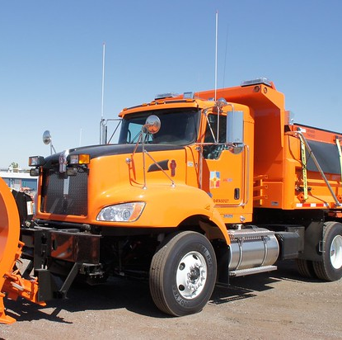
Road Equipment Capital Fund
Paver
Three-Ton Asphalt Hot Box and Recycler
2024 Estimated Net Fund Balance - $599,476
Notes:
$312,500K IN TOTAL EXPENSES

Slide 30
Recreation Operating Fund
Key Revenues
Key Expenditures
$142,500 in Real Estate Taxes
$54,500 in Charges for Services
Personnel
$57,000 in Maintenance
$72,500 in Recreation Activities
$60,000 Interfund Transfer to RCRF
2024 Estimated Net Fund Balance - $390,465
Notes:
The Recreation Fund is the operating budget for recreation programs and services, including overseeing 302 acres of park land and open space, numerous buildings and other recreation amenities. A dedicated tax levy of .180 mills will generate $140,500.
The Fund has two main sections: Building and Grounds and Participant Recreation. The former includes funding the mowing of our park space and open space. Participant Recreation includes the cost for summer camp operations, instructor fees, ticket purchases, and other program related expenses, including the pool at Hickory Park. Program fees and charges fund the cost of participant recreation services. Participant recreation services are budgeted at $72,500 in 2024. The cost for these services is consistent from year to year and varies based on program participation.

Slide 31
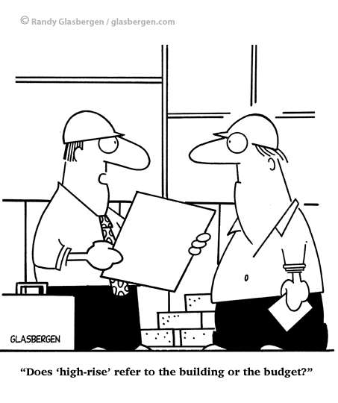
Capital Reserve Fund
Salt Shed at Public Works Facility
Replacement vehicle for Planning and Zoning Department
Electronic Sign to complete Municipal Building Renovation Project
hard costs related to replacing a culvert underneath Sanatoga Rd.
Completion of Swamp Creek Meadows Project
hard costs for the completion of the Swamp Creek Stream Restoration Project
Milling and Overlay of Sanatoga Road from Swamp Pike to the township line
2 Vehicles for the Police Department
2024 Estimated Net Fund Balance - $1,265,359
Notes:
CLOSE TO $1.94 MILLION IN ANTICIPATED EXPENSES

Slide 32
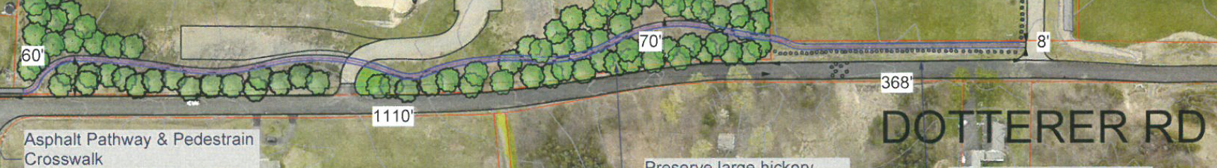
Recreation Capital Reserve Fund
Upgraded pump for the pool at Hickory Park
Upgrades to Barn
Renovate the hockey rink into pickleball courts (on hold for further discussion) at Community Park
Installation of a trail along Dotterer Road near Windlestrae Park
2024 Estimated Net Fund Balance - $267,437
Notes:
$90K IN TOTAL EXPENSES

Slide 33
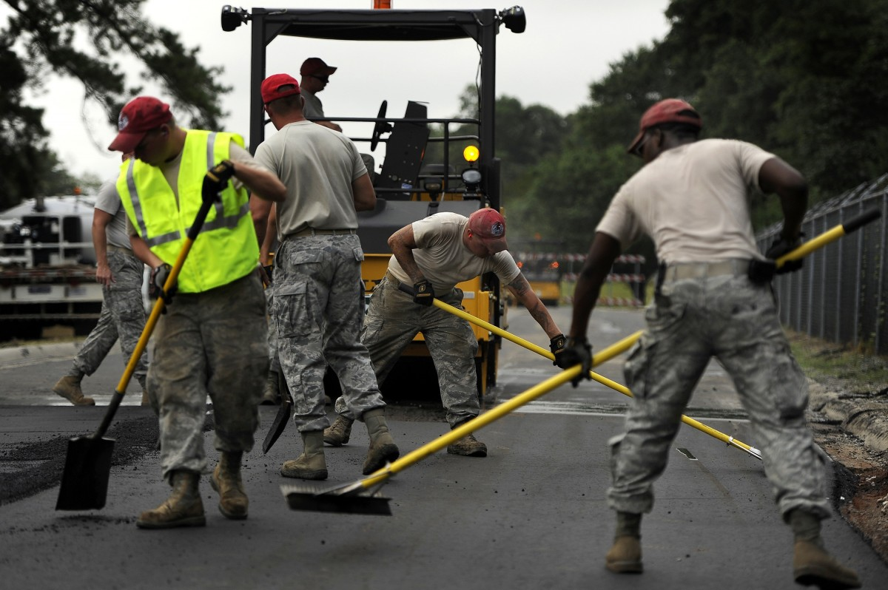
Liquid Fuels Fund
The Township will resurface or treat 7.5 miles of Township roads.
2024 Estimated Net Fund Balance
$493,117
This Photo by Unknown Author is licensed under CC BY-NC-ND
Notes:
State Shared Revenue = $505k
We will need to consider cutting projects if estimated bids do not come in lower than budgeted.

Slide 34
Notes:
The Township has at least 80 miles of road to maintain in its system. The general rule of thumb is a road should last at least 20 years; thus, the Township should be treating at least 4 miles of road annually. Total projected revenue in 2024 is $515,000 and appropriations are $409,000.

Slide 35

Future Trends and Outlook
This will be the 18th year in a row that taxes will not be raised (while reducing them in 2019).
GFOA recommends a municipality maintain no less than two months (16.6%) of fund balance reserves. At the end of 2024, the General Fund will have approximately 32% in fund balance reserves.
The Township will see some important revenue sources begin to level off in 2024 as current development is completed, but decisions on new development could change the outlook.
The Township is positioned to strategically plan future budgets and adjust appropriations to match available resources.
Notes:
Government Finance Officers Association

